Slide 1
An Introduction to AD Model Builder

Slide 2
Files
Input
  .tpl Code file
  .dat Data file
  .pin Initial parameter values file
Output
  .par Parameter estimate file
  .cor Correlation matrix file
  .rep User defined output file

Slide 3
Template: SECTIONS
DATA_SECTION
[INITIALIZATION_SECTION]
PARAMETER_SECTION
[PRELIMINARY_CALCS_SECTION]
PROCEDURE_SECTION
[FUNCTION]
[REPORT_SECTION]
[RUNTIME_SECTION]
[TOP_OF_MAIN_SECTION]
[GLOBALS_SECTION]
[BETWEEN_PHASES_SECTION]
[FINAL_SECTION]
Notes:
sections in bold are required

Slide 4
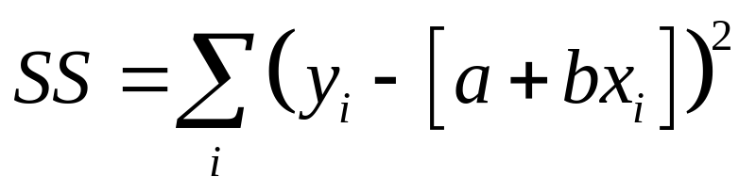
Simple Least Squares Regression
(Simple.TPL)
DATA_SECTION
init_int nobs
init_vector y(1,nobs)
init_vector x(1,nobs)
PARAMETER_SECTION
init_number a
init_number b
objective_function_value f
PROCEDURE_SECTION
f=0;
for (int i=1;i<=nobs;i++)
{
f+=square(y(i)-(a+b*x(i)));
}

Slide 5
DATA_SECTION
Defines variables to read data from file
Defines variables that will be constant in the model – no derivative values calculated for these variables
    int = integer
    number = floating point
    init_ prefix = read in data from file

Slide 6
DATA_SECTION
//this is a comment
init_int nobs
init_vector y(1,nobs)
init_vector x(1,nobs)

Slide 7
Data Input File (Simple.DAT)
Has to be the same order as in the DATA_SECTION
#This is a comment
#number of observations
# init_int nobs
10
# observed Y values
# init_vector y(1,nobs)
1.4 4.7 5.1 8.3 9.0 14.5 14.0 13.4 19.2 18
# observed x values
#init_vector x(1,nobs)
-1 0 1 2 3 4 5 6 7 8

Slide 8
PARAMETER_SECTION
Defines the parameters of the model
Defines variables to make the model calculations easier
init_ prefix means that these parameters will be given initial values and estimated in the minimization procedure
objective_function_value defines a variable that contains the value to be minimized
Derivative calculated for these parameters

Slide 9
PARAMETER_SECTION
init_number a
init_number b
objective_function_value f

Slide 10
Parameter Seed File (Simple.PIN)
Has to be the same order as the PARAMETER_SECTION
# init_number a
1
# init_number b
2

Slide 11
PROCEDURE_SECTION
Is written in C++ code and statements must end with a ;
Must use the model parameters (and data) to set a value for the objective function parameter

Slide 12
PROCEDURE_SECTION
f=0;
for (int i=1;i<=nobs;i++)
{
f+=square(y(i)-(a+b*x(i)));
}

Slide 13
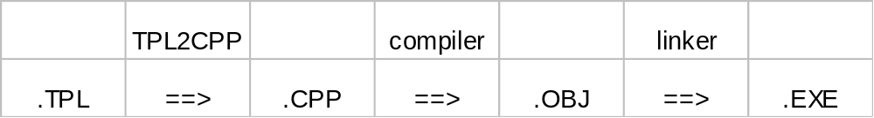
Creating Executable
Translate template into C++ code (tpl2cpp.exe)
Compile C++ code
Link with libraries

Slide 14
Create the executable
Open the dos prompt (or use IDE)
  Start->programs->accessories->command prompt
Go to the examples directory
  e.g. “cd c:\admb course\examples”
Type “admb simple”

Slide 15
Running Executable
simple
Describe the on screen output
Notes:
The -ind and -ainp options can be left out and the default files will be used root.dat and root.pin, where root = simple in this example

Slide 16
Parameter file (Simple.PAR)
# Objective function value = 19.9422
# a:
4.07818
# b:
1.90909

Slide 17
Using Matrix Algebra
Loop
for (int i=1;i<=nobs;i++)
{
y(i)=a+b*x(i);
}
Matrix algebra
y=a+b*x;

Slide 18
Using Matrix Algebra
PARAMETER_SECTION
.
vector pred_y(1,nobs)
.
PROCEDURE_SECTION
pred_y=a+b*x;
f=sum(square(pred_y-y));

Slide 19
User output
REPORT_SECTION
report<<"x data"<<endl;
report<<x<<endl;
report<<"y data"<<endl;
report<<y<<endl;
report<<"predicted y values"<<endl;
report<<pred_y<<endl;

Slide 20
simple.rep
x data
-1 0 1 2 3 4 5 6 7 8
y data
1.4 4.7 5.1 8.3 9 14.5 14 13.4 19.2 18
predicted y values
2.16909 4.07818 5.98727 7.89636 9.80545 11.7145 13.6236 15.5327 17.4418 19.3509

Slide 21
Error messages
Go through simple example and make some errors
  In tpl
  Syntax
  In dat
  In pin
Error in tpl2cpp – look at tpl line number
Error in cpp– look at cpp line number
Always change tpl
Safe – “-s” command line option – checks bounds in arrays

Slide 22
End

Slide 23
Error in keyword for tpl
E:\Ad Model course\December 2004\examples>makeadms simple
E:\Ad Model course\December 2004\examples>tpl2cpp simple
Error in line 13 while reading
f
…
Look at line 13 in the tpl file

Slide 24
Error in c++ code
E:\Ad Model course\December 2004\examples>tpl2cpp simple
xxglobal.tmp
xxhtop.tmp
header.tmp
xxalloc.tmp
xxtopm.tmp
1 file(s) copied.
E:\Ad Model course\December 2004\examples>call myegcs simple
E:\Ad Model course\December 2004\examples>gcc -fpermissive -c -O3 -x c++ -I. -Ic:/admodel/inclu
de -D__GNUDOS__ simple.cpp
simple.cpp: In method `void model_parameters::userfunction()':
simple.cpp:25: parse error before `{'
simple.cpp:26: parse error before `)'
simple.cpp: At top level:
simple.cpp:28: parse error before `}'
E:\Ad Model course\December 2004\examples>call linkegcs simple
E:\Ad Model course\December 2004\examples>gcc simple.o -osimple.exe -Xlinker -s -Lc:/admodel/
lib -ladmod -ladt -lads -lstdc++ -lm
Look at line 25 and 26 in the cpp file, but change in the tpl file

Slide 25
Missing data in .dat or .pin files
Missing data in .dat
  ** error reading file 'simple.dat' at line 5, field 0
    function: void cifstream::prefilter(); premature end of file?
    end of file
Missing data in .pin
  ** error reading file 'simple.pin' at line 4, field 0
  function: void cifstream::prefilter(); premature end of file?
  end of file
Behavior differs with different compilers

